Slide 1
ALGORITHM TO PREVENT COLLISIONS BETWEEN ROBOTIC BEES
Juliana Lalinde Velásquez
Isabel Urrego Gómez
Medellín, November 6

Slide 2
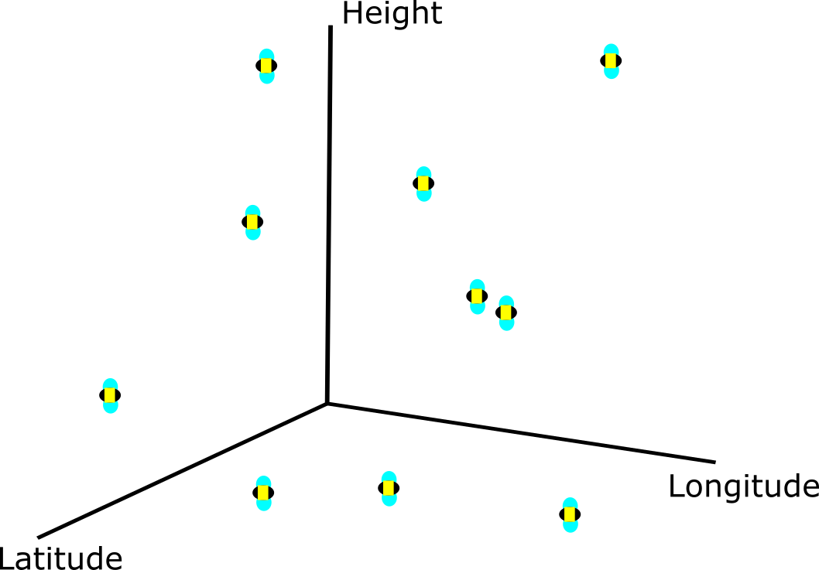
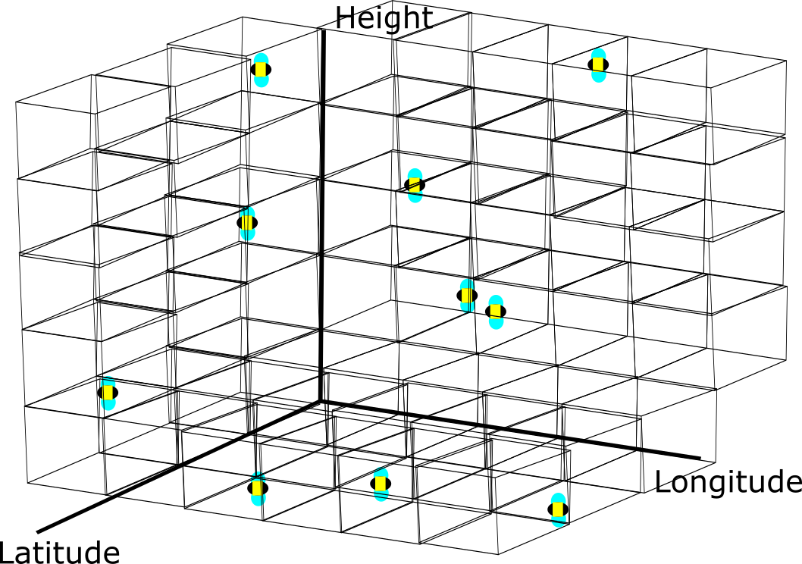
First Data Structure: Spatial Hashing
Figure 1: Example of the interpretation of the input
Figure 2: Bees classified by their coordinates using Spatial Hashing

Slide 3
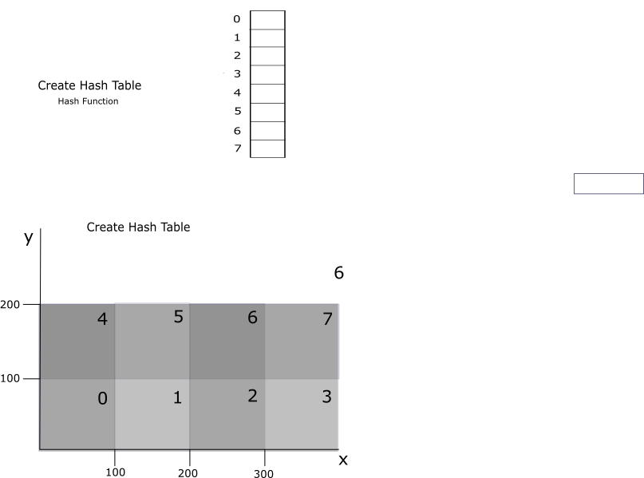
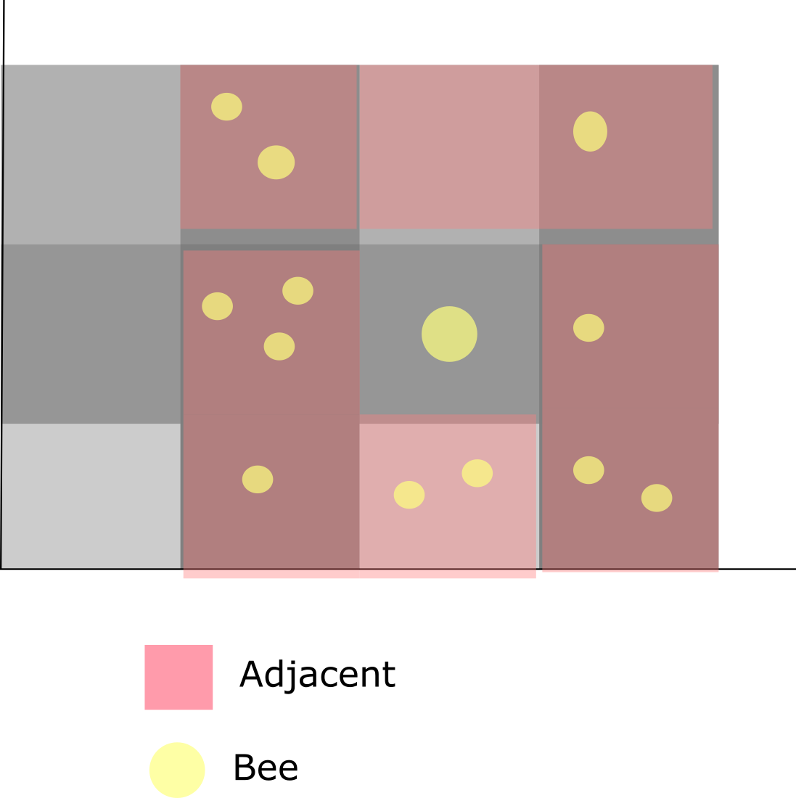
Data Structure Operations
Function | Average Complexity | Worst Case Complexity | Explanation of the variables
buildMatrix | O(n) | O(n) | n is the amount of bees
detectCollision | O(xyz) | O(xyz)=O(n^2) | x, y and z are the dimensions of the matrix
Table 1: Complexity of the operations
Figure 3: buildMatrix
Figure 4: detectCollision

Slide 4
Design Criteria of the Data Structure
Time efficiency: lower the number of comparisons.
The dimensions of the table depend on the maximum and minimum values in x,y and z.
Detecting a collision: Transverse the matrix and verify the size of the lists → case size of 1, case size > 1 O(xyz)
Adding one element on a List is O(1), therefore adding bees is O(1)

Slide 5
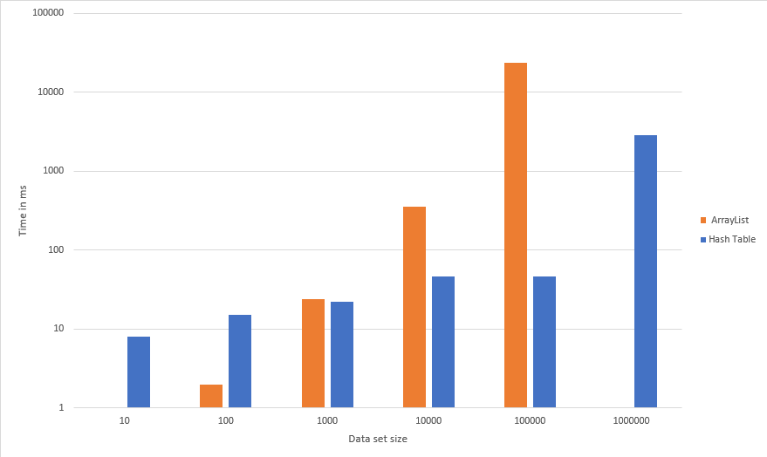
Time and Memory Consumption
DataSets | ArrayList | Hash Table
10 | 0 ms | 8 ms
100 | 2 ms | 15 ms
1000 | 24 ms | 22 ms
10000 | 356 ms | 46 ms
100000 | 23282 ms | 46 ms
1´000000 | -- | 2833 ms
Average time | 4732.8 ms | 495 ms
Figure 5: Time Consumption
Table 2: Time Consumption

Slide 6
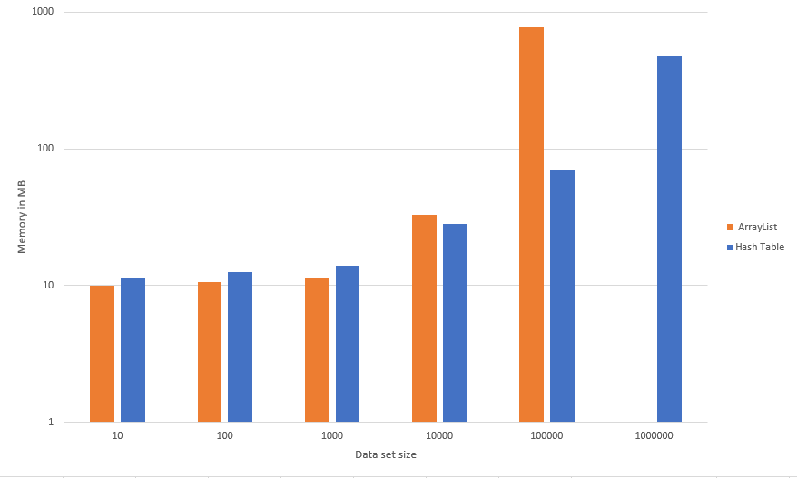
Time and Memory Consumption
DataSets | ArrayList | Hash Table
10 | 9.92 MB | 11.26 MB
100 | 10.59 MB | 12.61 MB
1000 | 11.27 MB | 13. 95 MB
10000 | 32.82 MB | 28.04 MB
100000 | 773.975 MB | 70.73 MB
1´000000 | -- | 474.59 MB
Table 3: Time Consumption
Figure 6: Memory Consumption

Slide 7
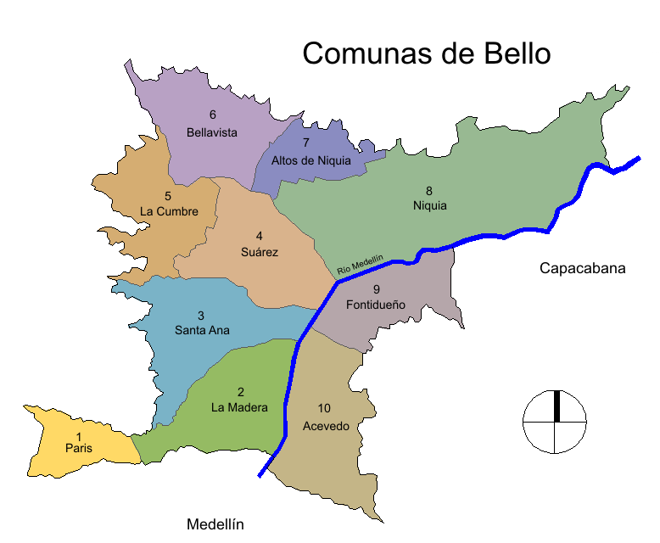
Implementation
Figure 7: Distribution of the bees in real life

Slide 8
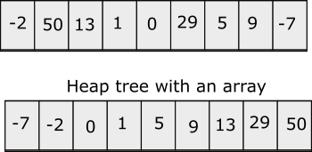
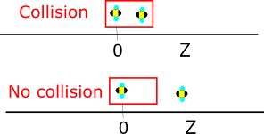
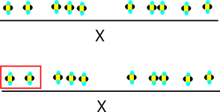
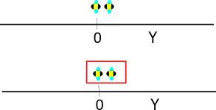
Second Data Structure: Heap Sort
Figure 8: Example of Heap Sort

Slide 9
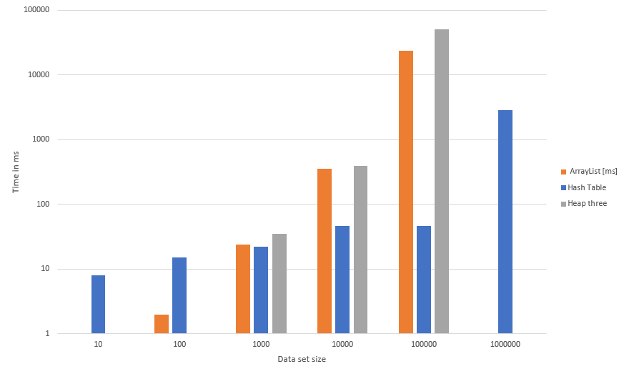
Time and Memory Consumption
DataSets | ArrayList | Hash Table
10 | 0 ms | 8 ms
100 | 2 ms | 15 ms
1000 | 24 ms | 22 ms
10000 | 356 ms | 46 ms
100000 | 23282 ms | 46 ms
1´000000 | -- | 2833 ms
Average time | 4732.8 ms | 10308.2 ms
Table 5: Time Consumption
Figure: Time Consumption

Slide 10
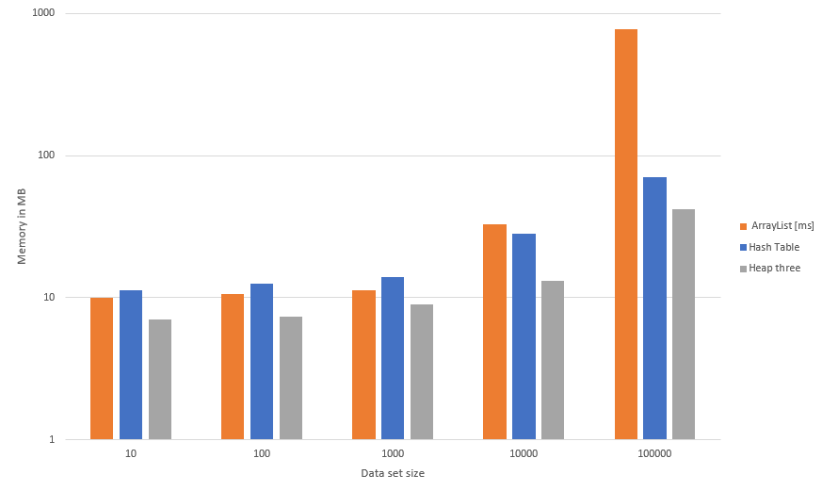
Time and Memory Consumption
DataSets | ArrayList | Hash Table | Heap Tree
10 | 9.92 MB | 11.26 MB | 7.06 MB
100 | 10.59 MB | 12.61 MB | 7.38 MB
1000 | 11.27 MB | 13. 95 MB | 9.01 MB
10000 | 32.82 MB | 28.04 MB | 13.2 MB
100000 | 773.975 MB | 70.73 MB | 42 MB
Table 3: Time Consumption
Figure 6: Memory Consumption

Slide 11
CONCLUSIONS

Slide 12
References
Klein, K. Robotic bee could help pollinate crops as real bees decline. NewScientist. Retrieved on August 26 2018: https://www.newscientist.com/article/2120832-robotic-bee-could-help-pollinate-crops-as-real-bees-decline/
2. Narasimha Karumanchi. 2018. Data structures and algorithms made easy in Java: data structure and algorithmic puzzles, Madinaguda, Hyerabad: CareerMonk Publications.
3. MacDonald, T. Spatial Hashing. Gamedev.net. Retrieved on August 26 2018: https://www.gamedev.net/articles/programming/general-and-gameplay-programming/spatial-hashing-r2697/
4. James. Introductory Guide to AABB Tree Collision Detection. AZURE FROM THE TRENCHES. Retrieved on August 25 of 2018: https://www.azurefromthetrenches.com/introductory-guide-to-aabb-tree-collision-detection/
5. Antonin Guttman. 1984. R-trees: a dynamic index structure for spatial searching. In Proceedings of the 1984 ACM SIGMOD international conference on Management of data (SIGMOD '84). ACM, New York, NY, USA, 47-57. DOI=http://ezproxy.eafit.edu.co:2079/10.1145/602259.602266
6. Jane Wilhelms and Allen Van Gelder. 1992. Octrees for faster isosurface generation. ACM Trans. Graph. 11, 3 (July 1992), 201-227. DOI=http://ezproxy.eafit.edu.co:2079/10.1145/130881.130882
7. Hosam M. Mahmoud. 2000. Sorting: A Distribution Theory, Wiley- Interscience Publications.

